Slide 1
GOMC Capstone SRS
Caleb Latimer
Muamer Besic
Ahmed Taher

Slide 2

What is GOMC?

Slide 3
Purpose, Scope, Objective
Used to generate different classifications of molecular systems
Layout, color scheme, number of pages, etc.
GitHub API v3 for announcements and updating downloads list
Config form for testing
Admin dashboard

Slide 4
Non-Functional Requirements
Performance
Reliability
Availability
Security
Maintainability
Portability

Slide 5
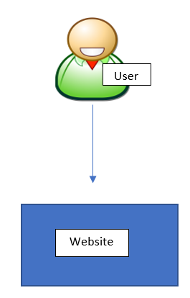
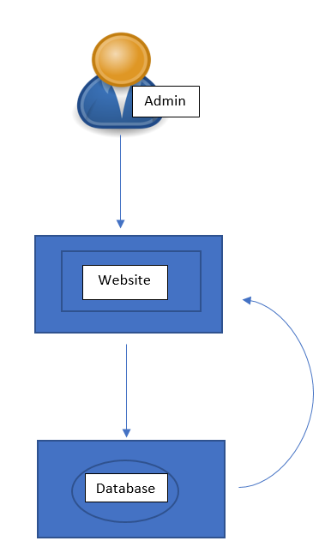
Product Perspective

Slide 6

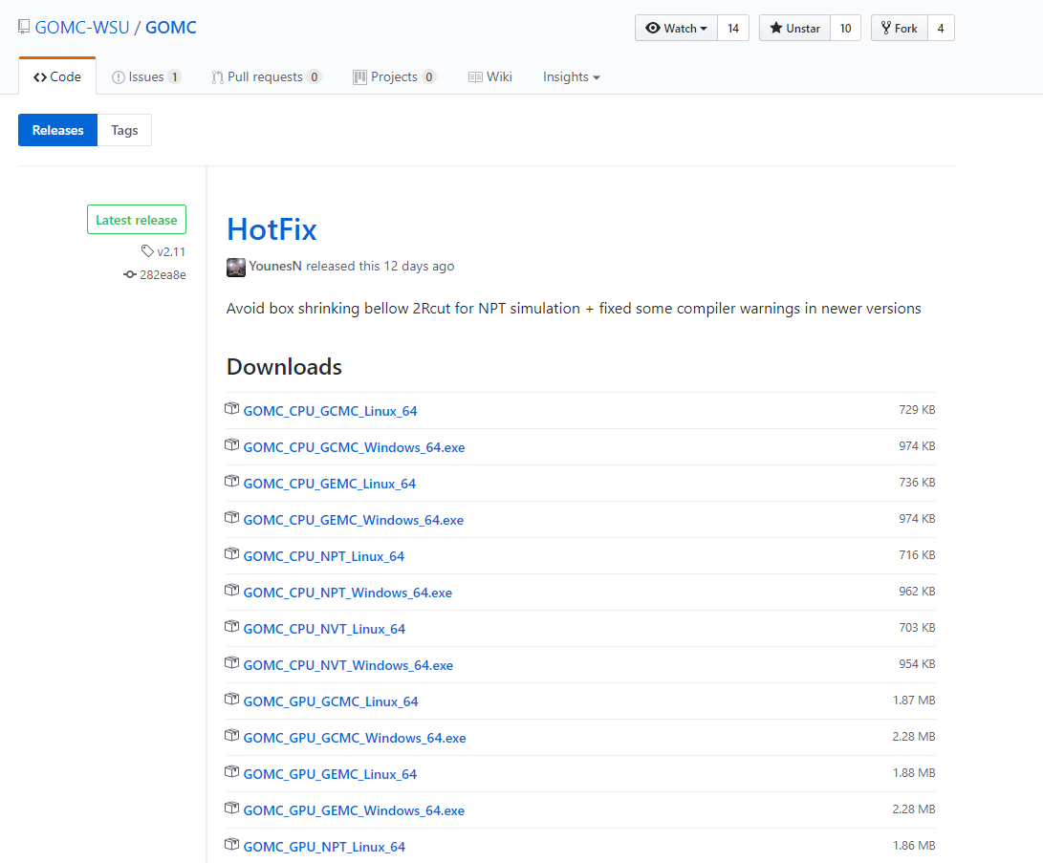
Product Functions
Navigation
Github Releases
Menu Navigation bar
GitHub Releases
User Registration
Links Available
Config Form
Resources Available

Slide 7
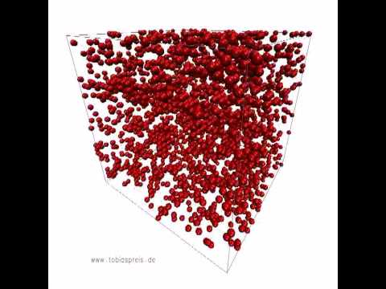
Simulation

Slide 8
Preview
Role
User Characteristics
UI

Slide 9

Meet R
Avg grad student
23-35
Practical
Impatient

Slide 10
User Wants
Download
Learn
Support

Slide 11
UI Needs
Software Plan
Distribution
Ready for beta & UV
1
Attractive
SEO
New features
Testing
Gulp JS
Materialize Components
QUnit
2
Bootstrap
HTML LESS jQuery AJAX
3

Slide 12
Requirement Set A
Mockups
Font-Scheme
UV six mockups with client
UV twenty-four font styles with client
Prototypes 1-1 & 1-2
2 different designs from M2,M3 and M6
UV with client
Consider feedback
Integrate with Backend
Deploy
Color Scheme
Nav-bar design
UV four color palettes with client
UV three menu designs with client

Slide 13
Requirement Set B
Content Layout
Footer Design
Continuous feedback
UV site-map and discuss content-layout
Discuss different footer designs while working on page-content
Continue adding content, doing UVs, handling feedback while on the way to prototype 2

Slide 14
Plan
UV
Get it to the client, get feedback and reprioritize tasks
03
Build
Develop website features and content
01
02
Test
Test, validate, code review and have it in our lower env

Slide 15
Overview
Team Lead
Requirements
DFDS

Slide 16
Config Req
Input Generator
Serve Download
Config Form
Correct Fields
Validation

Slide 17
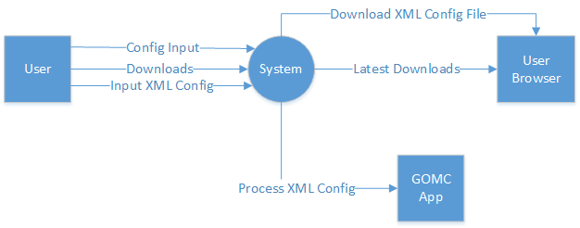
Website DFD-0

Slide 18
XML Req
Process Result
Error handling
XML Parse
Parse
Validation

Slide 19
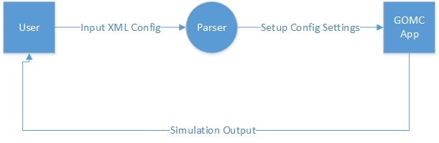
XML DFD-1

Slide 20
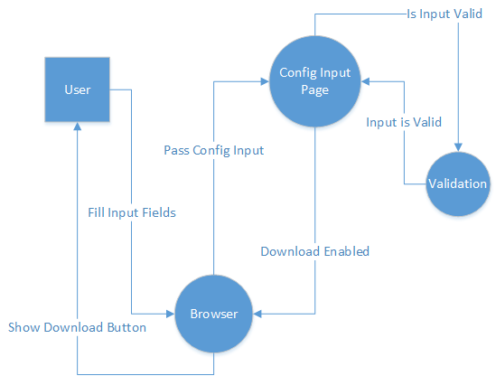
XML DFD-2

Slide 21
Conclusion

Slide 22
That’s all!

